Slide 1
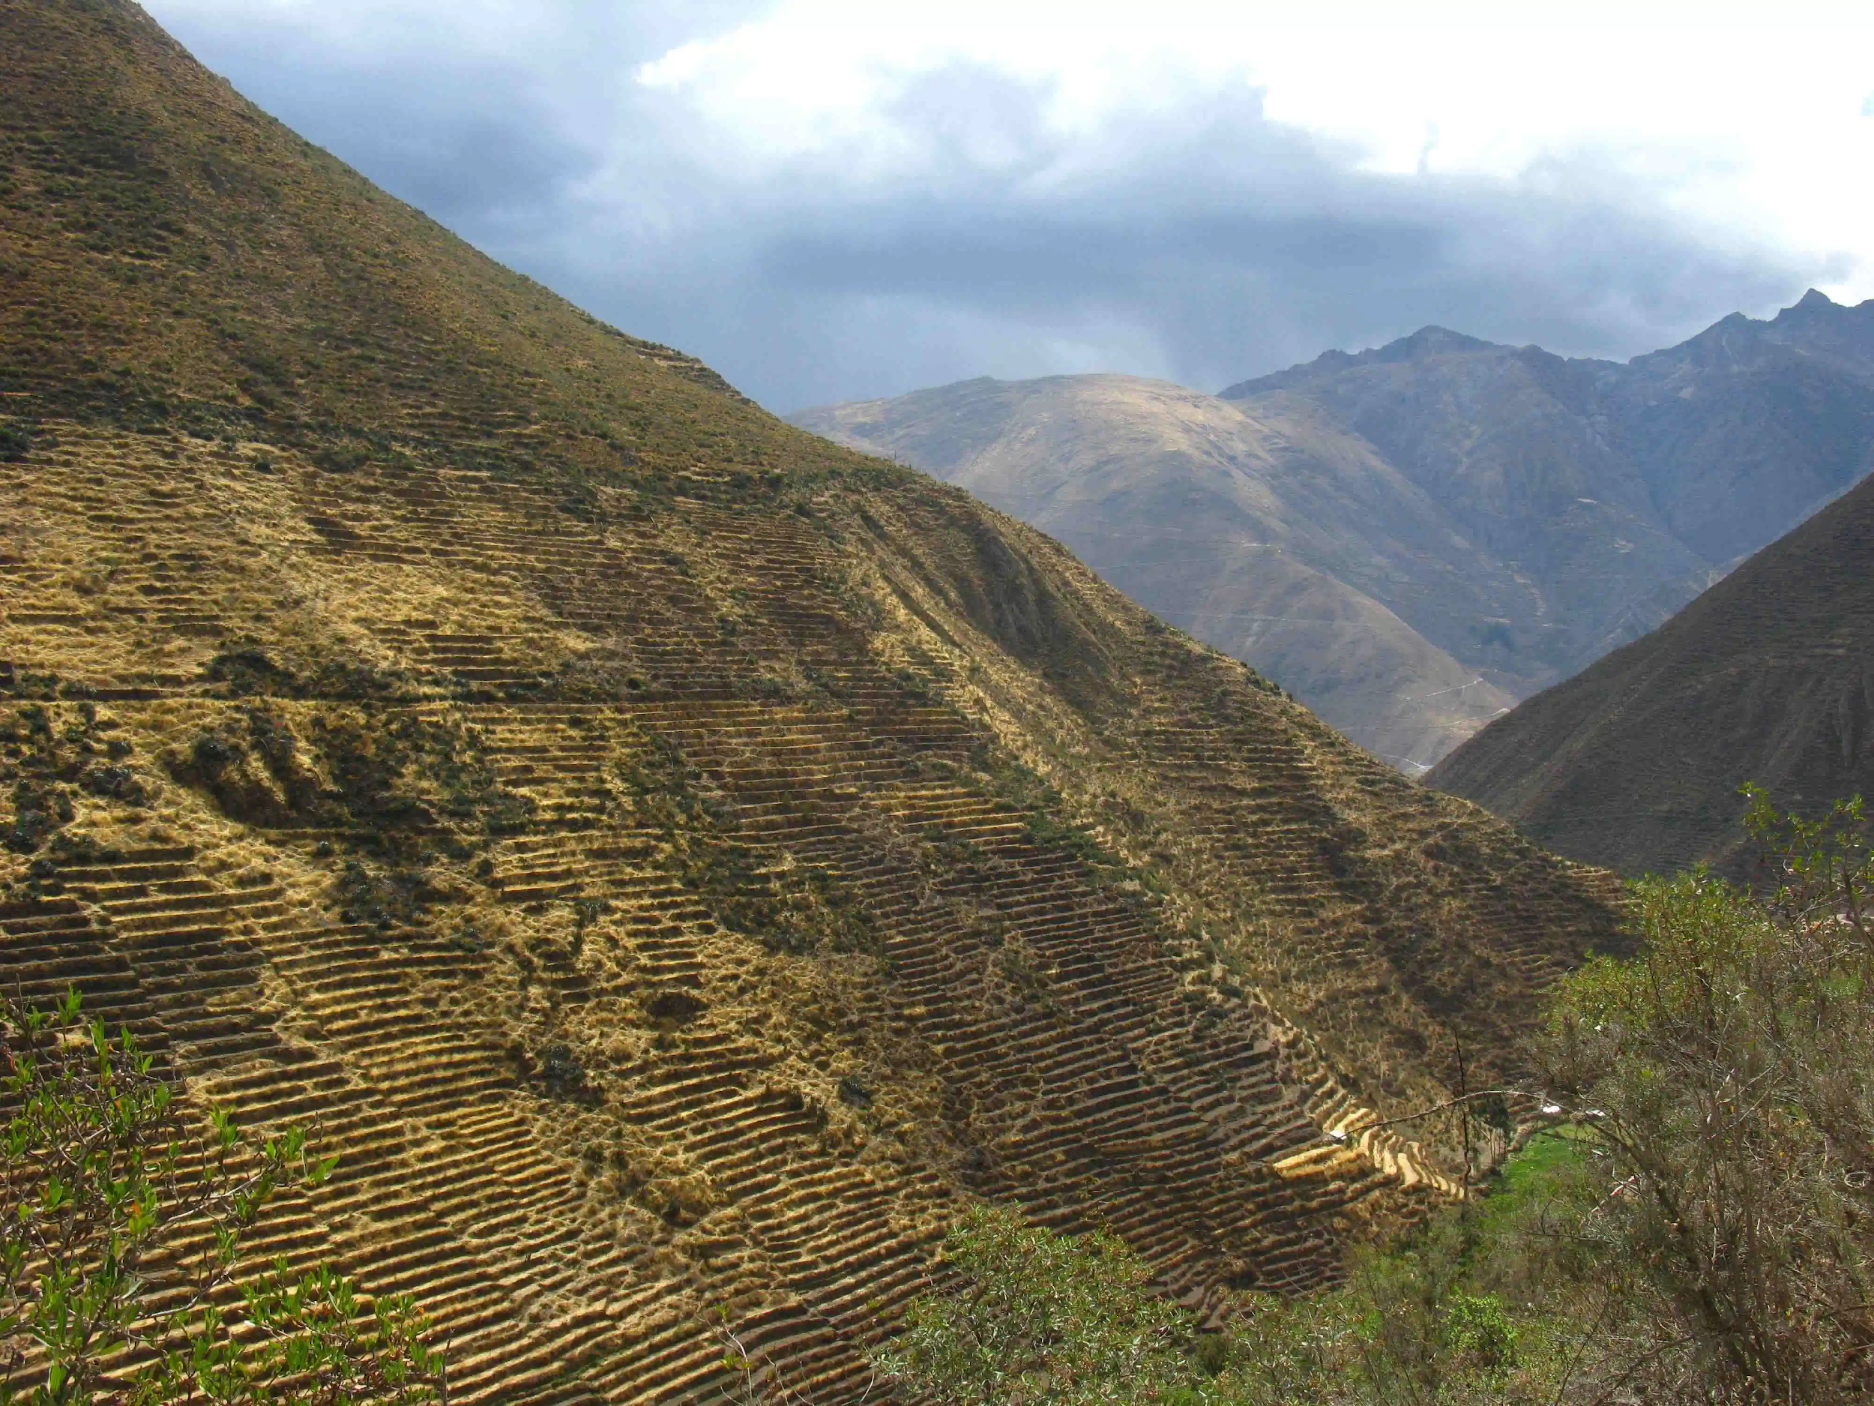
Heritage-led Planning for
Rural Communities:
Terrace landscapes in Peru
Sampoorna Bhattacharya
Rural Planning and Development + International Development Studies

Slide 2
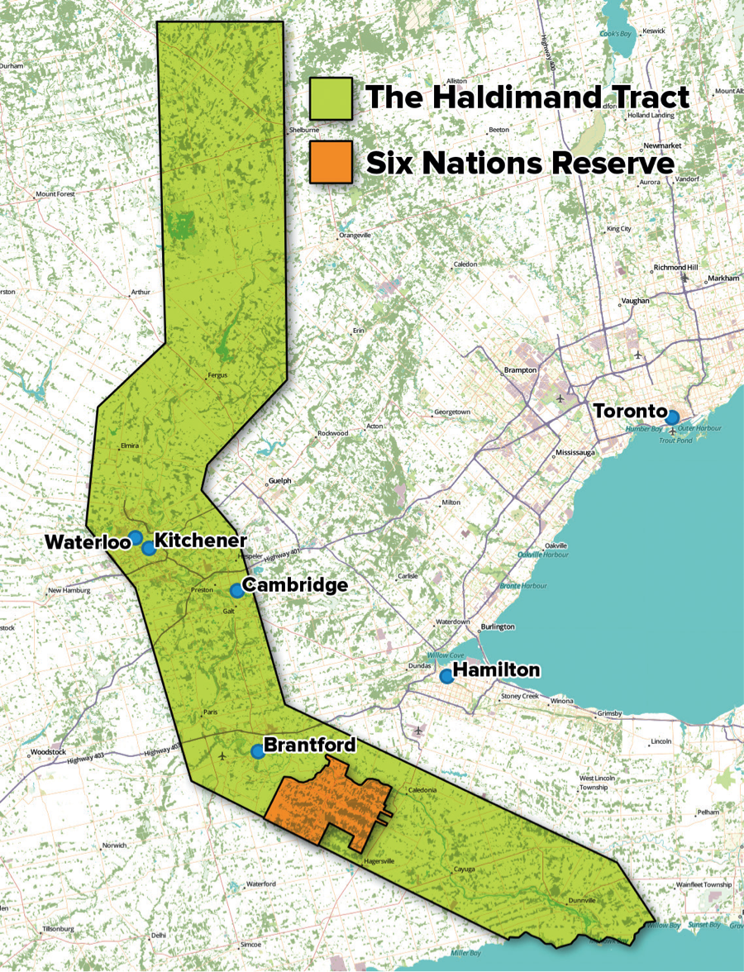
https://native-land.ca

Slide 3
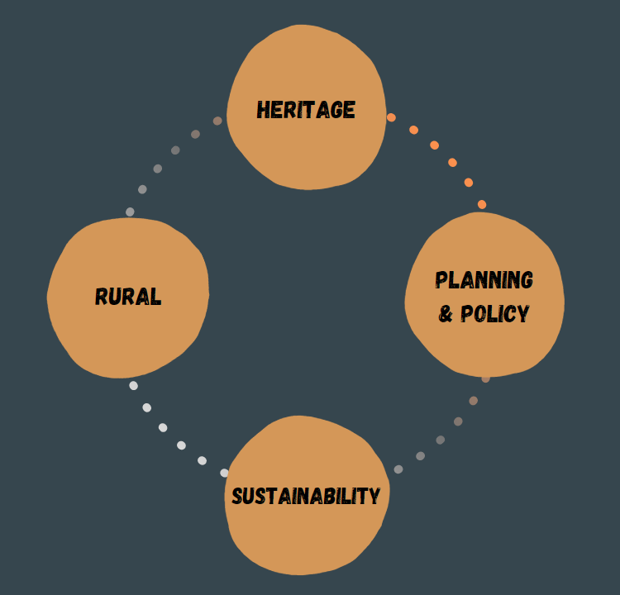
Positionality
M.Sc. Candidate in Rural Planning and Development with IDS
Supervisors - Dr. Leith Deacon and Dr. Silvia Sarapura
-
B.A. History and Theory of Architecture, Carleton University

Slide 4
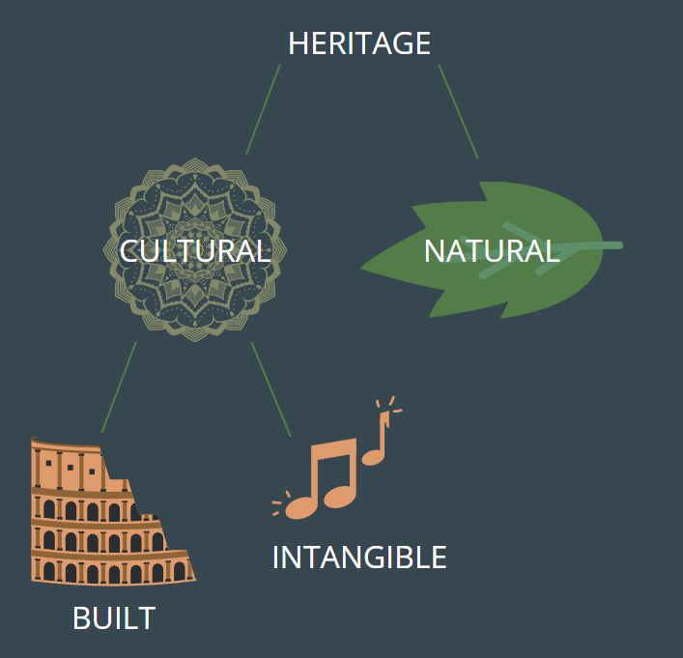
Why Rural Heritage?
Rural regions are at a higher risk of losing their heritage due to several reasons:
Migration from rural to urban regions
Modernization
Discrimination and marginalization
The structure of the heritage field
What does heritage mean to you?

Slide 5
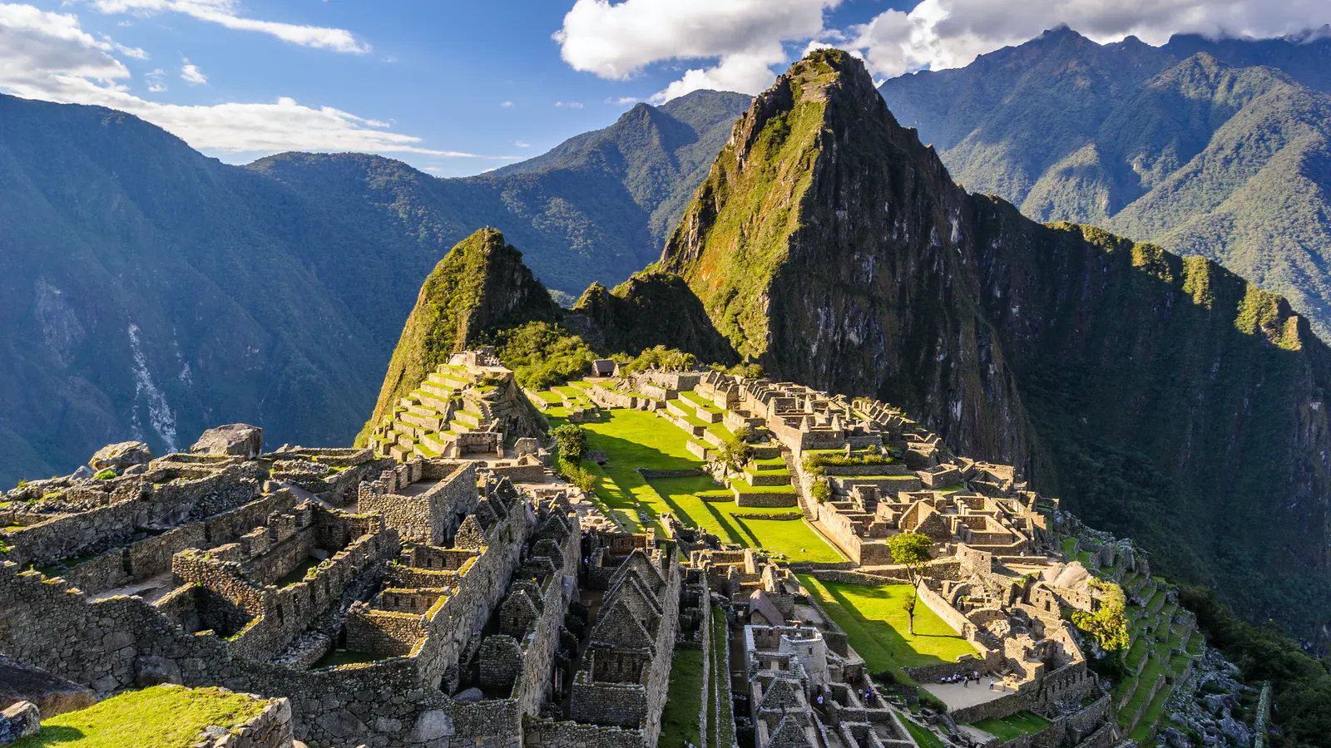
Peru & Heritage
The issue of over-tourism & unsustainable travel
The hypocrisy of Machu Picchu
Notes:
https://www.arcgis.com/apps/Cascade/index.html?appid=b998386badca40ba877412b8d5d7bf17
https://www.smithsonianmag.com/smart-news/perus-rainbow-mountain-could-be-danger-thanks-recent-popularity-180968962/
Palomo, I. (May, 2017). Climate Change Impacts on Ecosystem Services in High Mountain Areas: A Literature Review, Mountain Research and Development 37(2), pp. 179-187

Slide 6
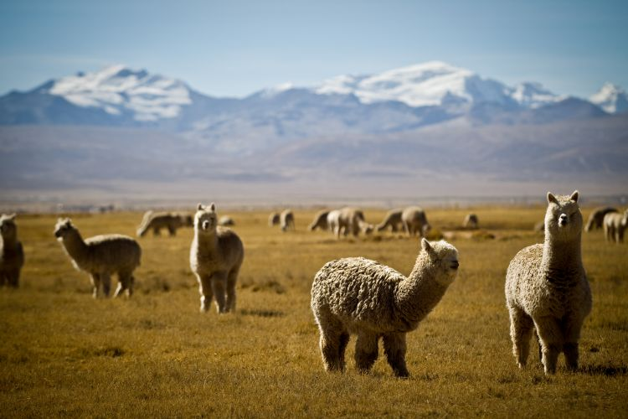
Regional Context
Study sites - high Andes region
Potato Park, Pisac
Nor-Yauyos-Cochas Landscape Reserve
Rural: 20%
Indigenous: 25 - 30%
Quechua/Kichwa: 83%
Aymara: 11%
Notes:
https://www.cia.gov/library/publications/the-world-factbook/geos/print_pe.html#:~:text=rural%3A%2053.2%25%20of%20population%20(,of%20population%20(2015%20est.)
https://www.iwgia.org/en/peru.html

Slide 7
Research Questions
What are the local attitudes towards terraces?
How are terraces being kept relevant in the face of rapid modernization and growing market demands?
What is the importance of terraces to local communities in terms of social, environmental, economic and governance aspects?

Slide 8
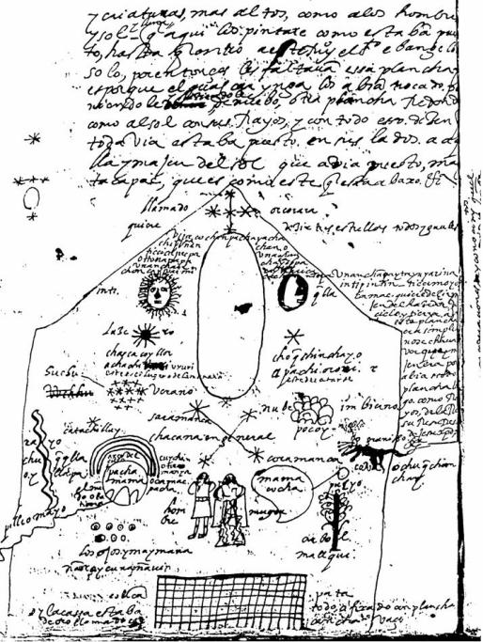
Andean Cosmovision
Ayni or reciprocity
Buen Vivir or Sumac Kawsay (Quechua) or living well
Notes:
https://www.pachamama.org/sumak-kawsay
https://www.theguardian.com/sustainable-business/blog/buen-vivir-philosophy-south-america-eduardo-gudynas

Slide 9
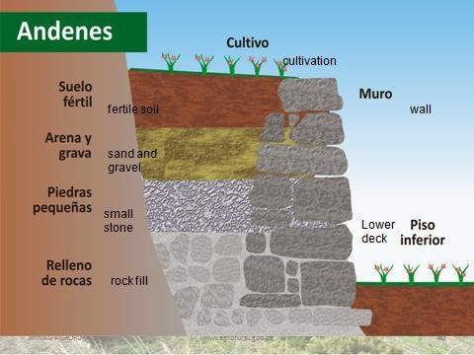
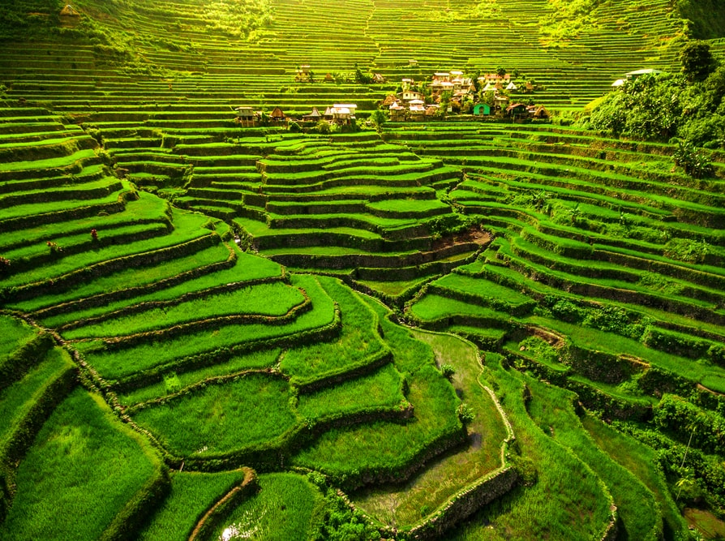
A closer look at terraces
Origins - Wari culture 500 - 1000
Why are they important?
Natural irrigation, climate control
Absorbs landslides
Where can they be found?

Slide 10
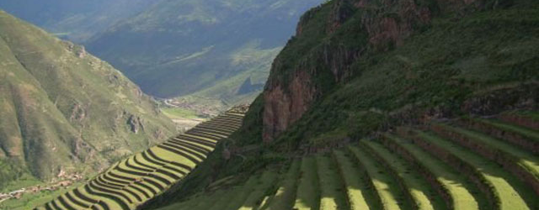
Terraces Now
Pre-Incan terraces (Nor-Yauyos-Cochas)
Incan terraces (Pisac)
The terraces are well-respected
Laraos Annual Maintenance of Terraces
But also...
Labour intensive
Aging caretaker
Climate change
Notes:
https://www.wmf.org/project/laraos-terraces

Slide 11
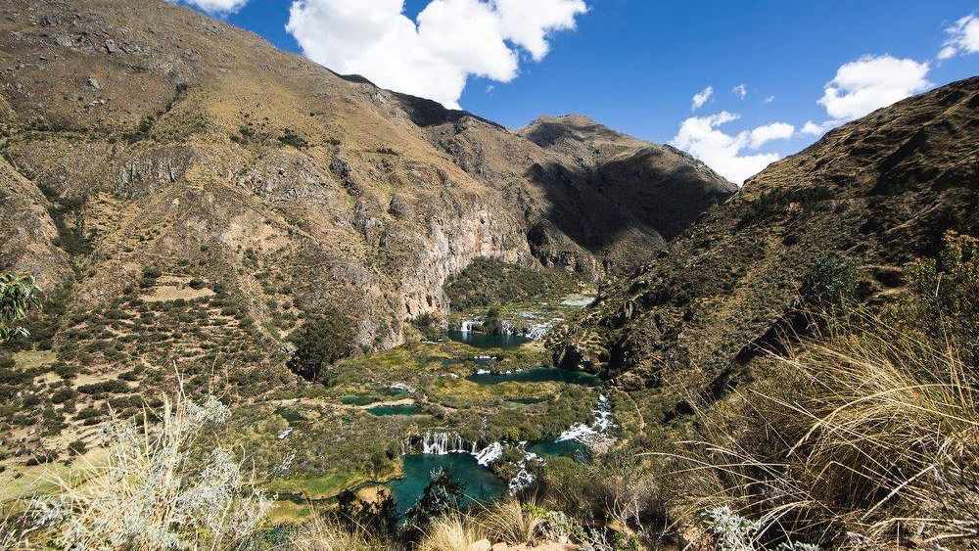
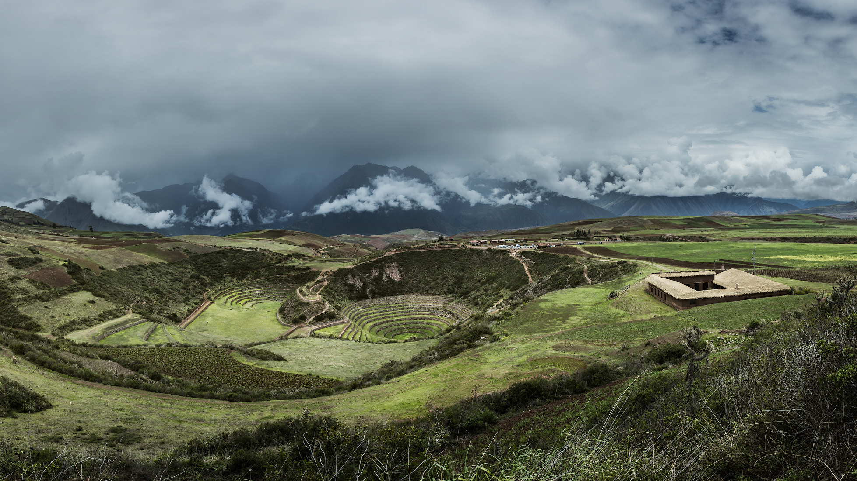
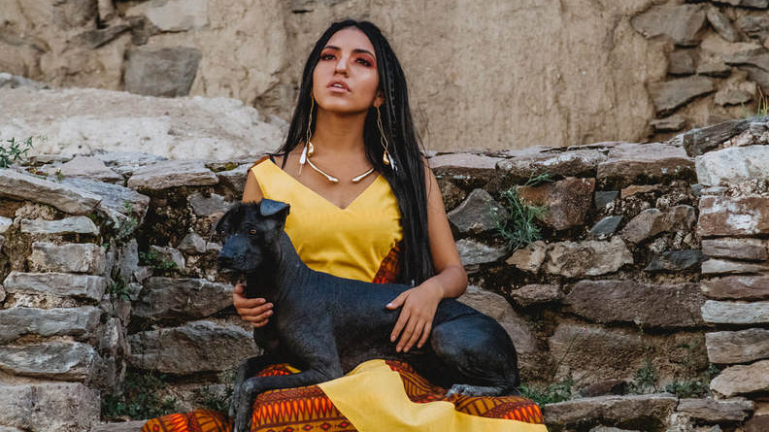
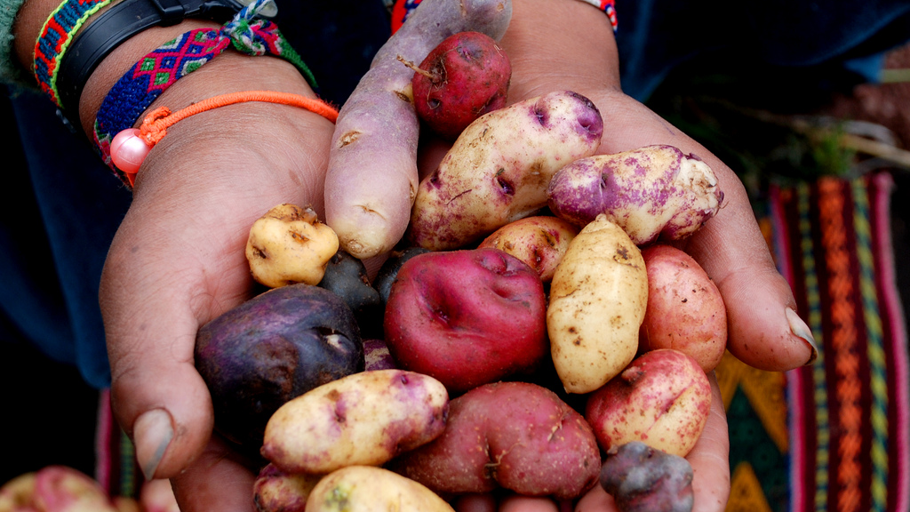
ECOTOURISM
CHEFS & CUISINES!
SOLUTIONS
GEOGRAPHIC INDICATORS
POP CULTURE
Notes:
https://www.eater.com/2018/2/21/17033912/mil-virgilio-martinez-cusco-peru-menu-reservations-photos-moray-ruins
https://news.mongabay.com/2018/03/over-720-million-in-profit-from-tourism-in-perus-protected-natural-areas/
https://www.nytimes.com/2020/04/28/world/americas/peru-indigenous-rap-renata-flores.html

Slide 12
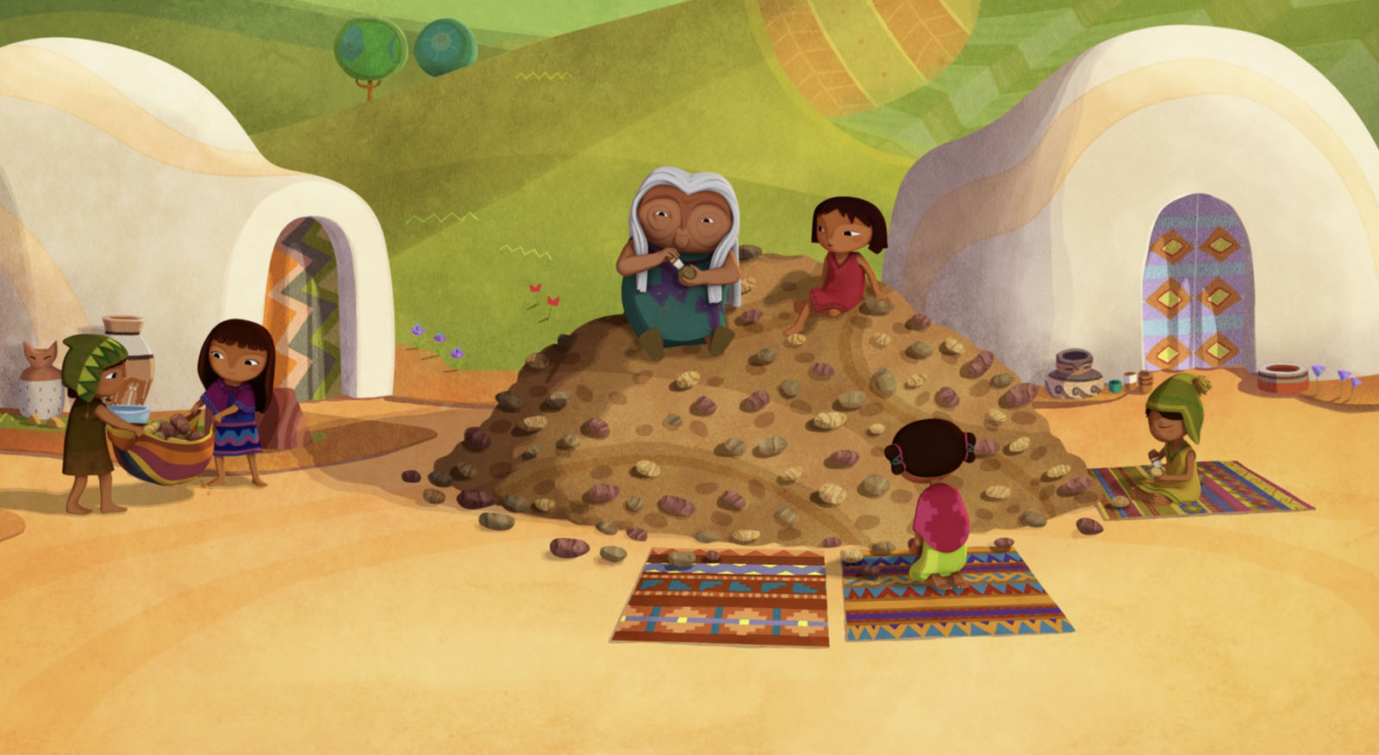
Thank you!
sampoorn@uoguelph.ca
Notes:
https://remezcla.com/film/trailer-netflix-pachamama-animated/

